Slide 1

OGF Interop Project update: IGE, EMI and FutureGrid
GIN-CG
Steve Crouch (IGE)
Ismael Carrion (IGE), Chris Koeritz (GEN/FG), Shahbaz Memon (EMI), Emmanouil Paisios (IGE), Marcin Pospieszny (IGE), Morris Riedel (EMI), Karolina Sarnowska-Upton (GEN/FG)

Slide 2

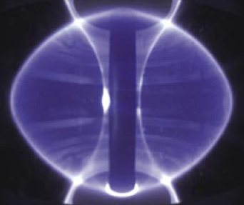
Standards, Data, Security & Application Support
Standards:
  HPC Basic Profile v1.0
    OGSA BES (Basic Execution Service) v1.0
    JSDL (Job Submission Description Language) v1.0
    HPC Profile Application Extension v1.0
  HPC File Staging Profile
Data protocols used is ftp
  Only suitable common protocol across all platforms!
Security:
  Direct middleware -> certificate CA trust (just import CAs)
Application:
  Physics: Plasma Charge Minimization
  Total system energy minimization of point charges around the surface of a sphere

Slide 3
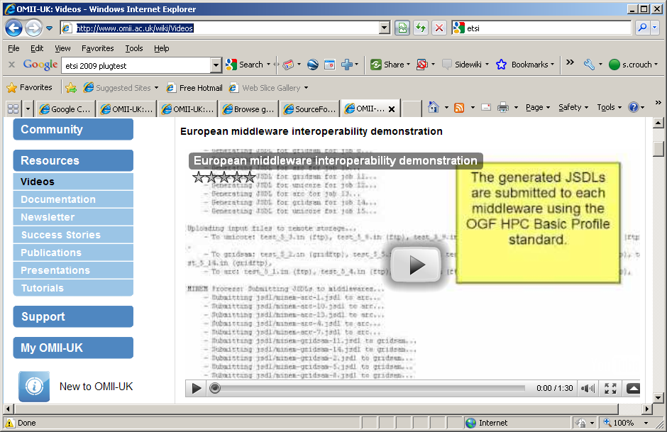
History
Initially shown at OGF27, Banff, Canada, Oct 09
SuperComputing, Nov 09, Nov 2010
ETSI Plugtests, FZJ, UK AHM, Dec 09
OGF28, OGF30, OGE34
Demonstrators: David Wallom, Peter Stefan, Morris Riedel, Shahbaz Memon, Steve Crouch
Video available at http://www.omii.ac.uk/wiki/Videos
Notes:
Thanks to participants, we’ve all gained a lot of experience with interop

Slide 4
Client/Service Compatibility
Service | BES++ Client |  | GridSAM Client
 | Invocation | Application | Invocation | Application
ARC |  | 
BES++ | - | -
Genesis II | (work.sol.) | (work.sol.) |  | 
GridSAM (+GridWay) |  |  | - | -
MS Com.Clus. |  |  | 
RENKEI |  |  | (work.sol.) | (work.sol.)
QosCosGrid |  |  | (work.sol.) | (work. sol.)
UNICORE |  |  |  | 
VENUS-BES |  |  | (work.sol.) | (work.sol.)
Notes:
Invocation – being able to use standards to launch jobs and monitor them
Application – able to get the application running successfully to completion
The ‘working solutions’ aren’t supported in the demo, but will be merged into the demo soon.

Slide 5
Endpoint Preparation
Application provision on resource
Data resource (file staging)
Security
‘Practical’ JSDL
Iterative testing

Slide 6



















How Interop Demo Fits Together Now…
HPC-BP¹
Minem
1. Create Minem input files
Minem
4
5
2. Generate JSDLs from template
1
7
FTP
2
minem-interop.pl
HPC-BP²
Minem
3. Upload input files
4. Submit JSDLs across middlewares
FTP
BES++
Client
3
5. Monitor jobs until completion
FTP
6
HPC-BP³
Minem
6. Download output files
7. Select best result
GridSAM
Client
8
8. Generate/upload image to web server
FTP
Client
Job Service
HPC-BP⁴
Minem
Data Service
Application
Security Service
…
Notes:
This is not fully inclusive of all types of endpoints, but shows the general idea.

Slide 7
Goal: IGE & EMI interop
IGE/EMI MoU: interop demo for SC2012
Our OGF34 plan for OGF36/SC2012:
  IGE v3.0 (GridSAM/GridWay)
  EMI latest (UNICORE/ARC)
  UMD – EGI packaging of the above!
  Genesis II

Slide 8
Goal: IGE & EMI interop
IGE/EMI MoU: interop demo for SC2012
Our OGF34 plan for OGF36/SC2012:
  IGE v3.0 (GridSAM/GridWay) - achieved
  EMI latest (UNICORE/ARC) - achieved, v2.0 Matterhorn release
  UMD – EGI packaging of the above! - not yet
  Genesis II - achieved

Slide 9
Goal: move towards Prod. Grids
Previously done with ‘historic’ interop endpoints – nearly all ‘testbed’
OGF 34 plan for OGF36/SC2012:
  IGE v3.0
  EMI
  Genesis II

Slide 10
Goal: move towards Prod. Grids
Previously done with ‘historic’ interop endpoints – nearly all ‘testbed’
OGF 34 plan for OGF36/SC2012:
  IGE v3.0 - IGE testbed only -> LRZ
  EMI - 2 instances on FutureGrid/XSEDE
    Non-EMI ‘security-light’ provided by Virginia
    v2.0 Matterhorn, full authorisation provided by FZJ
  Genesis II - FutureGrid/XSEDE

Slide 11
GridWay Metascheduler
The GridWay Metascheduler enables large-scale, reliable and efficient sharing of computing resources
It supports different LRM systems
  PBS, SGE, LSF, Condor…
  Within a single organization or across several administrative domains
GridWay uses different information, execution and transfer drivers that enable the interoperation with most existing Grid middlewares
GridWay provides two local interfaces: a command line interface (CLI) and a DRMAA-based interface. It provides a BES remote interface as well
Supported Standards:
  BES (both client and server)
  JSDL (POSIX and HPCProfile extensions)
  DRMAA, DRMAA2 (C, Java, Perl, Ruby and Python bindings)

Slide 12

UCM
BES
GridSAM
Job Submission Interfaces
CLI
DRMAA
GridWay Metascheduler
TUDO
LRZ
Computational and Storage
Resources
GRAM5
GridFtp
GRAM5
GridFtp
PBS
SGE
Cluster
Cluster
NIKHEF
EPCC
UTCN
PSNC
GRAM5
GridFtp
GRAM5
GridFtp
GRAM5
GridFtp
GRAM5
GridFtp
FORK
FORK
FORK
PBS
8 cores
1 core
4 cores
Cluster

Slide 13
UCM
BES
GridSAM
Job Submission Interfaces
Tightly coupled:
DRMAA direct to GridWay instance
CLI
DRMAA
GridWay Metascheduler
TUDO
LRZ
Computational and Storage
Resources
GRAM5
GridFtp
GRAM5
GridFtp
PBS
SGE
Cluster
Cluster
NIKHEF
EPCC
UTCN
PSNC
GRAM5
GridFtp
GRAM5
GridFtp
GRAM5
GridFtp
GRAM5
GridFtp
FORK
FORK
FORK
PBS
8 cores
1 core
4 cores
Cluster

Slide 14
Some Results
Security
  Generally, 2/3 of effort
  Different implementation/deployment, different constraints (e.g. our two UNICORE deployments)
  Used a duff certificate – no UNICORE!
  Cert breaking an RFC?
Clients need to be flexible
  Within a grouping of jobs across different endpoints
  Support different endpoint security profiles?
BES/JSDL
  Generally more convergent
  WS Addressing
  Deployment e.g. WorkingDirectory
Standards compliance is obviously important but largely not enough – obvious, but extent is not obvious

Slide 15








In the Future…
ARC
FTP
EMI -> UMD
Taverna/Triana
UNICORE
GridSAM
GridWay
GridSAM
Client
FTP
BES++
Client
GT
IGE -> UMD
GridFTP
FTP
Genesis
…

Slide 16
Future Work
New Redmine GIN-CG subproject to host stuff
  Endpoint Wiki (like we did in OGF27/OGF30)
  Status e.g. last interop check between implementations
HPC-BP Implementation Interoperability - Experiences Document
  ‘Structural’ draft uploaded to Redmine GIN-CG interop demo subproject
  Areas: OGSA-BES/JSDL (inc. headers), Security, Data transfer
Bring in other endpoint types and prod. grids
  ARC endpoint (NorduGrid?)
  IGE -> LRZ
  Others?
CHAIN interoperability demo?
SC2012 prep?
  Video for backup

Slide 17
Future Work
Another application?
Data protocols other than FTP!
  GridFTP, SFTP, FTPS, …?
  Go beyond ‘lowest common denominator’ of protocol
Beyond submission and monitoring
Common problem of duration of grid demo
  Problem of resource availability -> very long demos!
  If jobs submitted and monitored, already demo’d interop
  Timeout after x demo seconds, work with ‘what we’ve got’
Investigate extensibility with Triana/Taverna2
  Integrate GridSAM client as a plugin into Triana/Taverna
  Basic job submission/monitoring in workflow
  Replicate interop Minem application demo in workflow

